Slide 1
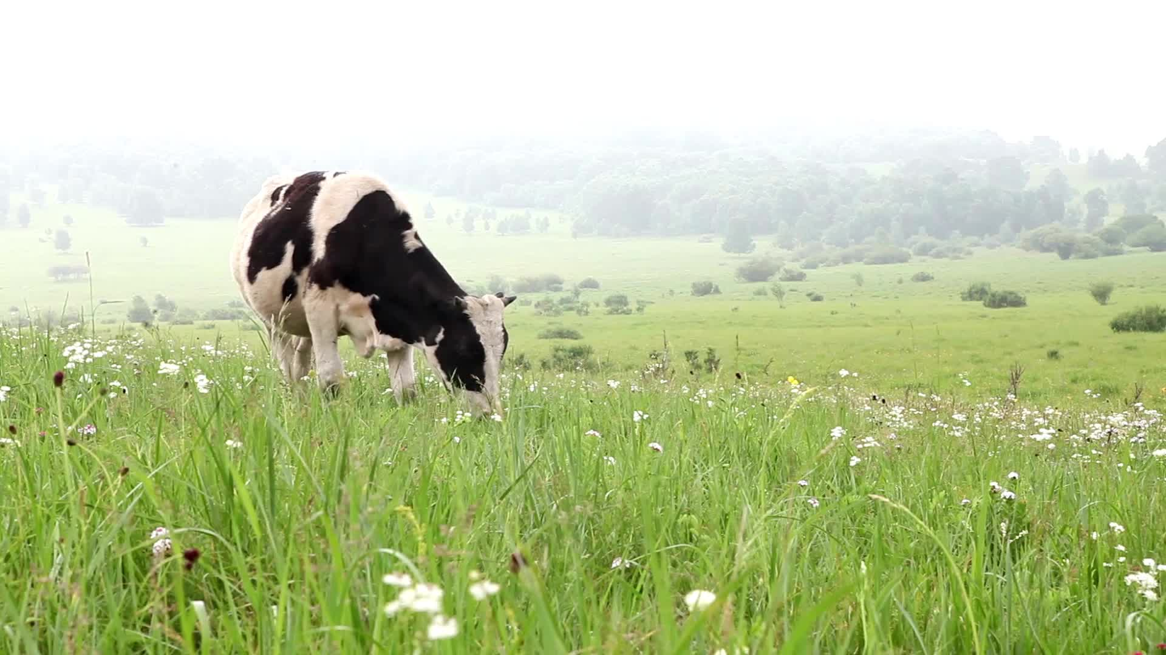

C7084 Assignment – Cattle Treatments and Movement database
Joseph Mitchell
Github: joebmitchell
Cheshire, UK
28/03/2024

Slide 2
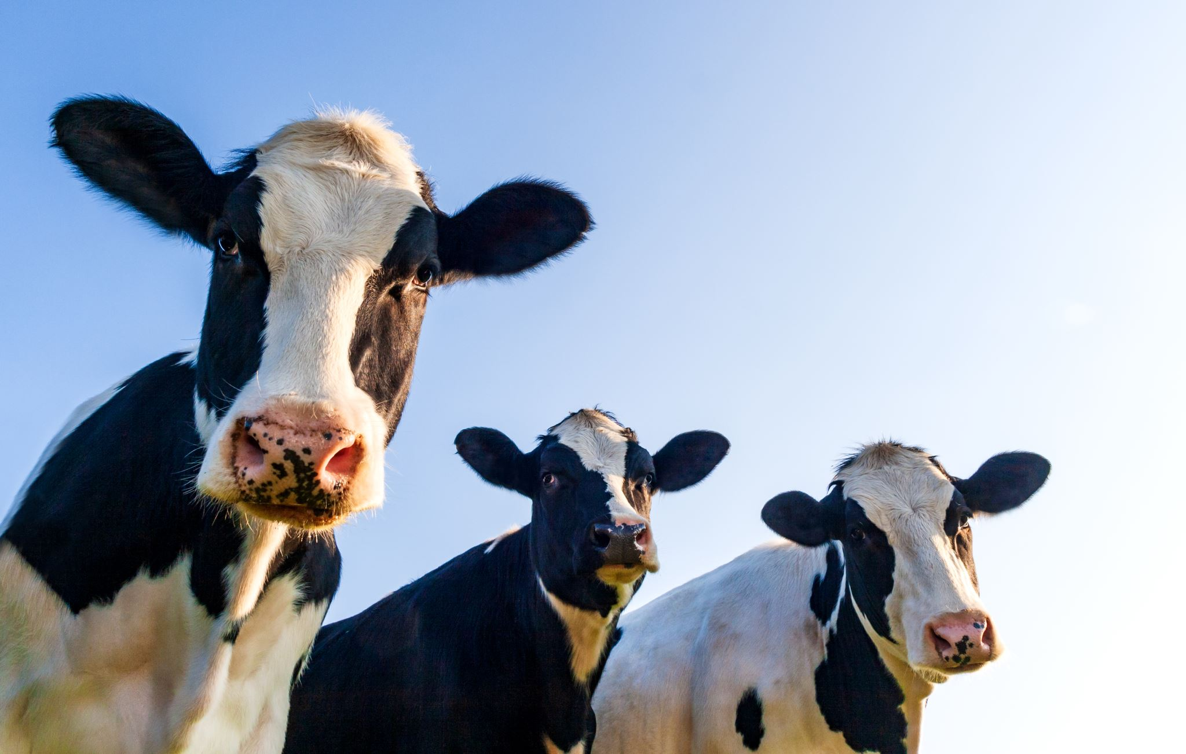
Introduction
Notes:
There are approximately 9.4 million cattle in the UK currently and at the minute there is an outdated database that stores the relevant information but it is currently incapable of linking this information with treatment records. If this data was stored in a database that was linked to animal information it would provide crucial extra information for food safety with withdrawal period information as well as being a valuable resource for research into what treatments are used on UK farms.

Slide 3
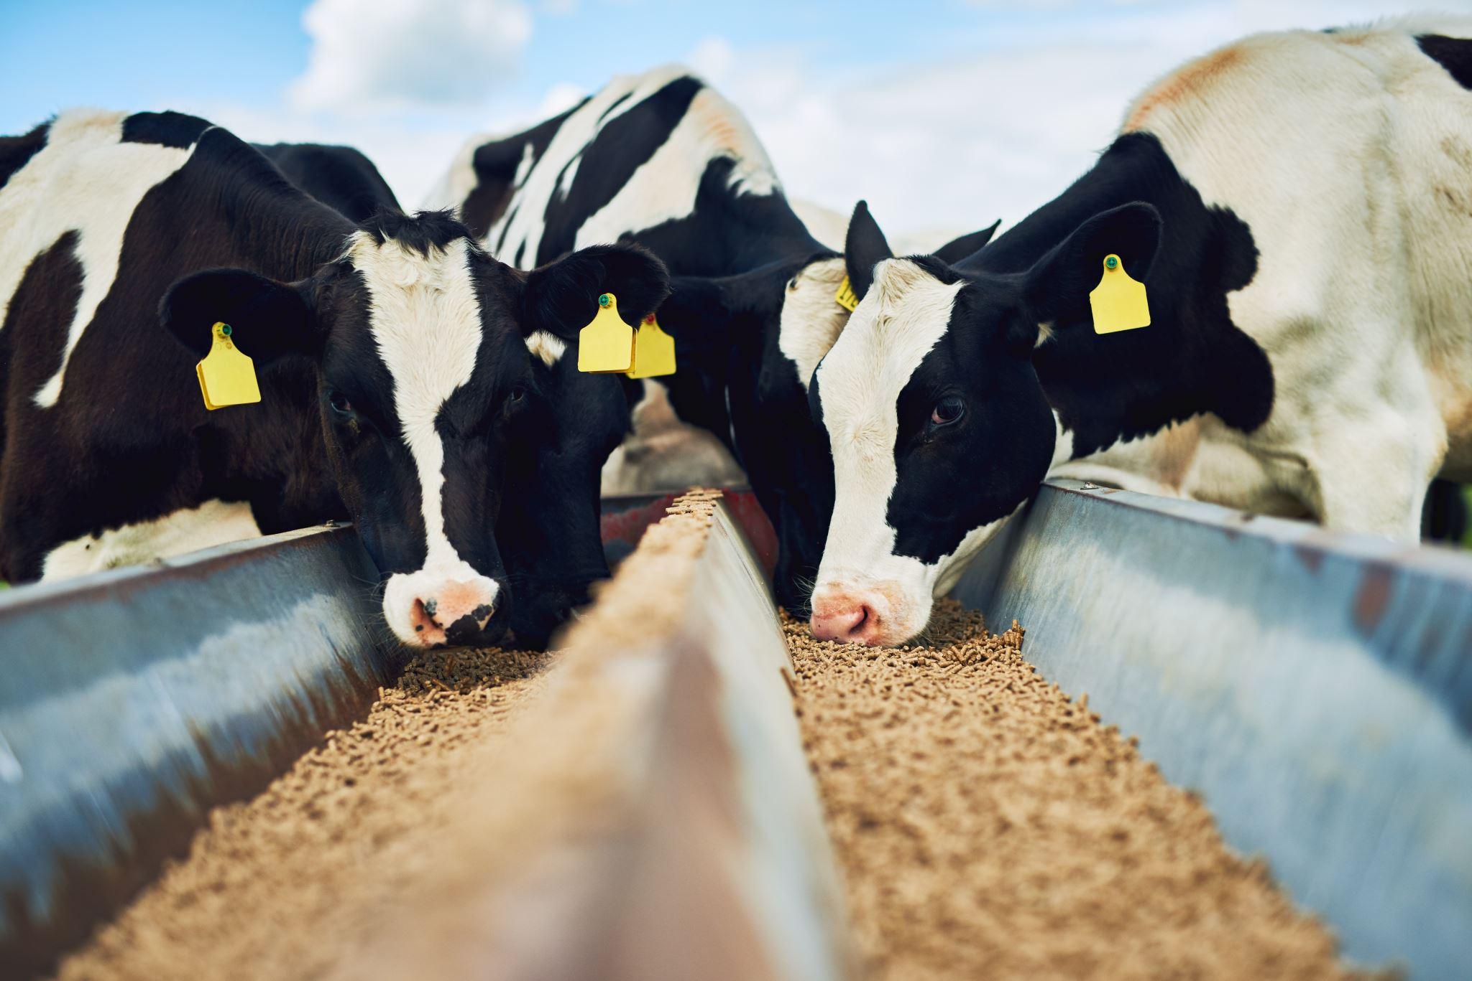
Database Structure

Slide 4
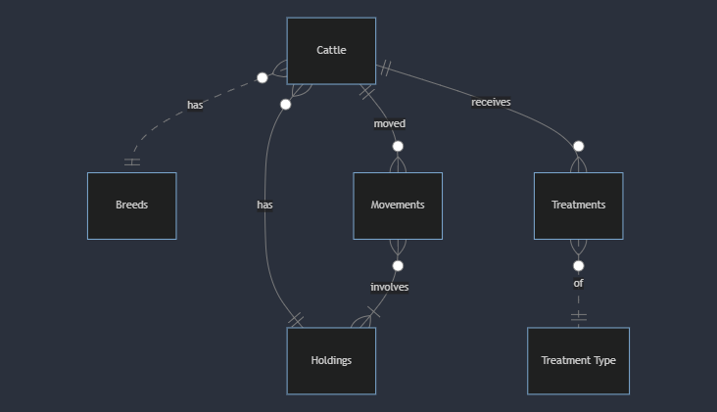
Entity-Relationship Diagram
Notes:
The main tables in the database are:
Cattle: contains information relating to each cow resistered including dob, sex, breed, dam, sire, as well as information which is expected to be updated such as their current holding, status (alive/dead) and when they’re under meat withdrawal until
Holdings : This is a table that contains information about holdings that are registered
Movements: Is a record of every movement of a cow, so every movement relates to one cow but every cow can have multiple movements. Similarly each holding can be related to multiple movements and each movement involves two holdings ( a from holding and a to holding)
Breeds: This is a simple table that contains the breed names identified by their primary key which is used as a foreign key in the cattle table. So every cow can have only 1 breed and every breed can relate to multiple cows.
Treatment Type: This is a table containing possible treatments licenced for use in cattle
Treatments: This is a record of treatments given to a specific animal. Every treatment can only be given to one cow but each cow can have multiple treatments. Every treatment can only be of one treatment type but each treatment type can apply to multiple treatments.
Mention constrains if time

Slide 5
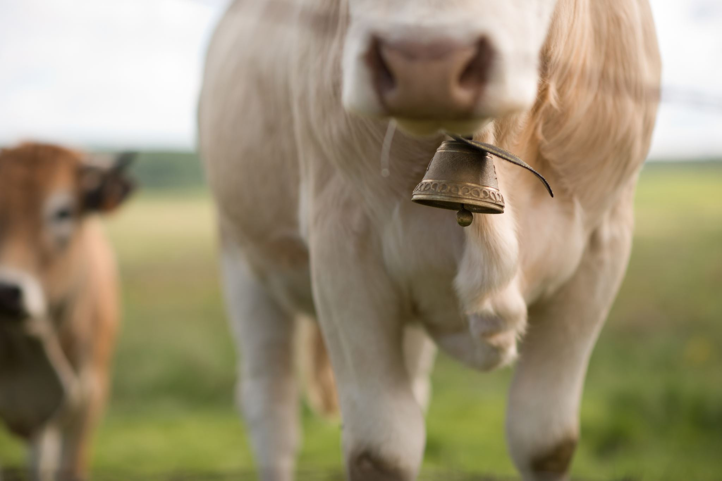
Key Features

Slide 6
Key Features
Provide an accurate and upto date location for all cattle in the UK
Provide an accurate and upto date list of all animals at every location registered with BCMS
In the event of a disease outbreak:
Trace where cattle have moved to from an infected premises
Trace what cattle have moved onto an infected premises
Record all medical treatments given to all cattle
Maintain an upto date record of when each animal can enter the food chain
Notes:
There are some limitations such as not being able to take into account and flag up movements that shouldn’t be allowed to happen due to movement restrictions placed

Slide 7
Conclusion
Notes:
So in conclusion this database will provide a place to store cattle id information and medical treatments that they have received which will improve food security by providing a way to check that an animal is truly out of its withdrawal periods and so can safely enter the food chain. There are further features to be added such as reasons for treatments and user access controls but having a centralised system for recording animal treatments will bring benefits to farmers, processors and consumers.

